Slide 1
Part 2 Process management
Chapter6 CPU Scheduling

Slide 2
Content
Basic Concepts
Scheduling Criteria
Scheduling Algorithms
Thread Scheduling
algorithm for a particular system
Operating System Examples

Slide 3
Objectives
To introduce CPU scheduling, which is the basis for multiprogrammed operating systems
To describe various CPU-scheduling algorithms
To discuss evaluation criteria for selecting a CPU-scheduling algorithm for a particular system

Slide 4
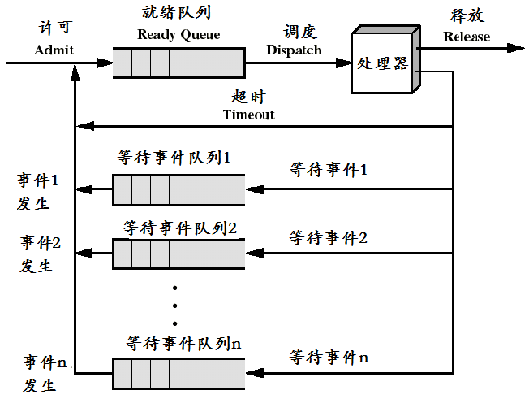
1.Basic Concepts:处理机调度
Objective: Maximum CPU utilization obtained with multiprogramming

Slide 5
Basic Concepts（cont)
Three aspects:
  CPU和I/O
  CPU Scheduler
  Dispatcher

Slide 6
(1)CPU和I/O
CPU–I/O Burst Cycle
  Process execution consists of a cycle of CPU execution and I/O wait
CPU burst distribution

Slide 7
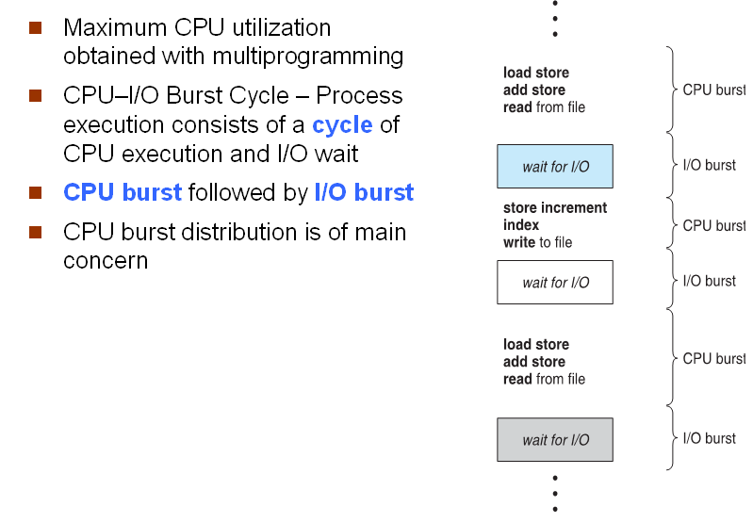
Alternating Sequence of CPU and I/O Bursts

Slide 8

Histogram of CPU-burst Times

Slide 9
I/O-bound process and CPU-bound process
I/O-bound process and A CPU-bound process
  An I/O-bound process ------is one that spends more of its time doing I/O than it spends doing computations.
  A CPU-bound process ------- generates I/O requests infrequently, using more of its time doing computations.
进程调度的关键----It is important that the long-term scheduler select a mix of I/O-bound and CPU-bound processes.

Slide 10
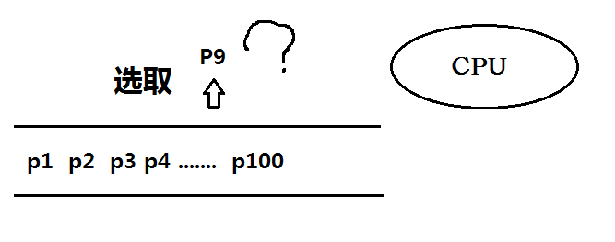
(2) CPU Scheduler 调度程序
Selects from among the processes in memory that are ready to execute
allocates the CPU to one of them.

Slide 11
Review
Long-term Scheduling （长程调度或高级调度）
Medium-Term Scheduling（中级调度又称中程调度）
Short-term Scheduling （短程调度或低级调度）

Slide 12
（a） Long-term Scheduling
从外存后备队列中选取某作业调入内存
Job scheduling is required to make two decisions:
  How many jobs allowed to run in memory
  Which job will be selected.

Slide 13
（b） Medium-Term Scheduling
To improve memory utilization(利用率) and system throughput(吞吐量)
Dispatch those processes can not be run to external memory
Set their states ready or suspended

Slide 14
（c） Short-term Scheduling ----CPU Scheduling
Selects from among the processes in memory that are ready to execute
allocates the CPU to one of them

Slide 15
（c） CPU Scheduling
保存处理机的现场
  保存当前进程处理机现场：程序计数器、多个通用寄存器内容送入PCB相应单元
按照某种算法选取进程
  从就绪队列中选取一个进程，将它状态改为运行
把处理器分配给进程
  把处理机分配给该进程，恢复处理机现场，将信息从PCB装入处理机：程序计数器、多个通用寄存器

Slide 16
（c） CPU Scheduling
Non-preemptive（非抢占方式）
  Once the processors is allocated to a process, let it perform some tasks ,until the process is completed or it is blocked by the occurrence of an event
Scheduling take place when a process:
  Terminates
  Switches from running to waiting （I / O requests）
  Some kind of primitive is executed in process communication or synchronization, such as Block primitive(阻塞原语）, Wakeup primitives（唤醒原语）

Slide 17
（2） CPU Scheduling
preemptive （抢占方式）
  Allows the scheduler stop a running process based on certain principles, reassigned processors to another process
Scheduling take place when a process:
  Switches from running to ready state
  Switches from waiting to ready
preemptive causes
  Consider access to shared data
  Consider preemption while in kernel mode
  Consider interrupts occurring during crucial OS activities

Slide 18
(3)Dispatcher （分发程序）
schedule: 调度, scheduler调度算法
dispatch: 分发、派发。 dispatcher分发程序，将请求派发。
Dispatcher
  Dispatcher module gives control of the CPU to the process selected by the short-term scheduler
Tasks of dispatcher module involves:
  switching context
  switching to user mode
  jumping to the proper location in the user program to restart that program
Dispatch latency (调度延迟)
  time it takes for the dispatcher to stop one process and start another running

Slide 19
2. Scheduling Criteria
General Criteria
Optimization Criteria

Slide 20
(1) General Criteria
(a) CPU utilization (利用率）
  keep the CPU as busy as possible
(b) Throughput （吞吐量）
  processes that complete their execution per time unit（单位时间内完成的进程数），对工作量的一种度量

Slide 21
(1) General Criteria（cont)
(c) Turnaround time （周转时间）
  amount of time to execute a particular process
  从进程提交到进程完成的时间间隔为周转时间
  包括：外存后备队列上等待时间、进程在就绪队列中等待调度时间、CPU上执行时间、等待I/O完成时间

Slide 22
(1) General Criteria（cont)
(d) Waiting time (等待时间）
  amount of time a process has been waiting in the ready queue
  等待时间是进程在就绪队列中耗费时间的总和。
  CPU 调度算法并不能影响进程的执行时间和I/O 操作时间；它只能影响进程在就绪队列中等待的时间

Slide 23
(1) General Criteria（cont)
(e) Response time (响应时间）
  amount of time it takes from when a request was submitted until the first response is produced, not output (for time-sharing environment)
  从进程提交请求到产生首次响应的时间,这被称为响应时间
  在交互式系统中，周转时间可能不是最好的指标； 响应时间更重要

Slide 24
(2) Optimization Criteria
Max CPU utilization
Max throughput
Min turnaround time
Min waiting time
Min response time

Slide 25
3.Scheduling Algorithms
FCFS Scheduling(先来先服务)
SJF Scheduling（短作业优先调度）
Priority Scheduling
Round Robin (RR)
Multilevel Queue Scheduling

Slide 26
(1) FCFS Scheduling
Example
  Process Burst Time
  P₁ 24
  P₂ 3
  P₃ 3

Slide 27
(1) FCFS Scheduling
Suppose that the processes arrive in the order: P₁ ,P₂ , P₃ The Gantt Chart for the schedule is:
Waiting time for P1 = 0; P2 = 24; P3 = 27
Average waiting time: (0 + 24 + 27)/3 = 17
P₁
P₂
P₃
0
24
27
30

Slide 28
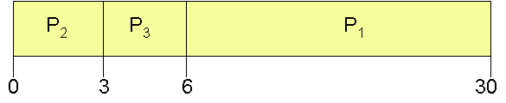
FCFS Scheduling(Cont)
Suppose that the processes arrive in the order
P₂ , P₃ , P₁
The Gantt chart for the schedule is:
Waiting time for P1 = 6; P2 = 0; P3 = 3
Average waiting time: (6 + 0 + 3)/3 = 3
Much better than previous case
Convoy effect short process behind long process
前一个实例中出现------护航效应( Convoy effect ): 许多短的进程,等待一个大的进程释放CPU以后才能轮到

Slide 29
FCFS 优缺点
算法容易实现
但效率不高
只考虑作业等待时间
没考虑作业要求服务时间的长短。
有利于长作业而不利于短作业。

Slide 30
(2) SJF Scheduling
Definition
Schemes
Example

Slide 31
(2) SJF Scheduling
Definition
  Associate with each process the length of its next CPU burst. Use these lengths to schedule the process with the shortest time.
  SJF is optimal – gives minimum average waiting time for a given set of processes

Slide 32
(2) SJF Scheduling
Two schemes:
  Nonpreemptive
    once CPU given to the process it cannot be preempted until completes its CPU burst.
  Preemptive
    If a new process arrives with CPU burst length less than remaining time of current executing process, preempt.
    This scheme is know as the Shortest-Remaining-Time-First (SRTF).

Slide 33
(2) SJF Scheduling
Example of Non-Preemptive SJF
Process Arrival Time Burst Time
P₁ 0.0 7
P₂ 2.0 4
P₃ 4.0 1
P₄ 5.0 4

Slide 34
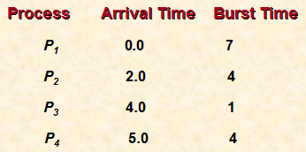
(2) SJF Scheduling
The Gantt chart for the schedule is
P₁
P₃
P₂
P₄
0
3
7
8
12
16
Average waiting time = (0 + 6 + 3 + 7)/4 =4

Slide 35
(2) SJF Scheduling
Example of Preemptive SJF
Process Arrival Time Burst Time
P₁ 0.0 7
P₂ 2.0 4
P₃ 4.0 1
P₄ 5.0 4

Slide 36
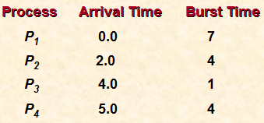
(2) SJF Scheduling
  The Gantt chart for the schedule is
  Average waiting time = (9 + 1 + 0 +2)/4 =3
P₁
P₂
P₃
P₂
P₄
P₁
0
2
4
5
7
11
16

Slide 37
(2) SJF Scheduling
SJF is optimal – gives minimum average waiting time for a given set of processes
  The difficulty is knowing the length of the next CPU request
  Could ask the user

Slide 38
SRTF
SRTF ：最短剩余时间优先算法
方法 ： 选择具有最少剩余时间的进程进行调度。

Slide 39
SJF and SRTF discussion
They can be applied either to a whole program or the current CPU burst of each program
  Idea is to get short jobs out of the system
  More efficient on short jobs
  Result is better average waiting time
The best you can do at minimizing average waiting time
  Provably optimal (SJF among non-preemptive, SRTF among preemptive)‏----gives minimum average waiting time for a given set of processes
  Since SRTF is always at least as good as SJF, focus on SRTF

Slide 40
SJF and SRTF discussion(cont)
What if all jobs have the same length?
  SRTF becomes the same as FCFS (i.e. FCFS is best can do if all jobs the same length)‏
What if jobs have varying length?
  SRTF (and RR): short jobs not stuck behind long ones
SRTF can lead to starvation if many small jobs!
  Large jobs never get to run
Optimal
Hard to predict the future, unfair

Slide 41
What if the behavior of processes is unknown?
Ask the user
  When you submit a job, have to say how long it will take
  To stop cheating, system kills job if takes too long
  Even non-malicious users have trouble predicting runtime of their jobs
Adapting SRTF
  Use SRTF as a yardstick for measuring other policies
  Predicting the length of next CPU burst

Slide 42


Determining Length of Next CPU Burst
Can only estimate the length
Can be done by using the length of previous CPU bursts, using exponential averaging(指数平均数)
Notes:
在预测中，参数ɑ控制近来和过去历史预测的权重。tn 包含了最近的实际信息；τn 则包含了过去的历史预测信息。

Slide 43

Prediction of the Length of the Next CPU Burst

Slide 44
Examples of Exponential Averaging
α =0
  τ_{n+1} = τ_{n}
  Recent history does not count
α =1
  τ_{n+1} = α tn
  Only the actual last CPU burst counts
If we expand the formula, we get:
    τ_{n+1} = α t_{n}+(1 - α)α t_{n} ₋₁ + …
    +(1 - α )^{j} α t_{n} _{-j} + …
    +(1 - α )^{n +1} τ₀
Since both α and (1 - α) are less than or equal to 1, each successive term has less weight than its predecessor
Notes:
如果ɑ = 0，那么τn+1 = τn，近来的历史没有产生影响（假定当前的条件是瞬时的）；如果ɑ = 1，那么τn+1 = tn,，只有最近的CPU burst 有作用（假设历史记录陈旧了，没有关系了）。
因为ɑ和(1 - ɑ)都小于或等于1，所以每一后项的权重都要小于其前一项。

Slide 45
SJF 优缺点
算法易于实现。但效率不高。
主要缺点：
  忽视了作业等待时间;
  会出现饥饿现象。
SJF算法与FCFS算法的比较：
  SJF的平均作业周转时间比FCFS要小，故它的调度性能比FCFS好。
SJF调度算法的问题：
  需要知道作业所需运行时间，否则调度就没有依据，不可能精确计算出一个作业的运行时间。

Slide 46
(3) Priority Scheduling
A priority number (integer) is associated with each process
The CPU is allocated to the process with the highest priority (smallest integer ≡ highest priority)
  Preemptive
  nonpreemptive

Slide 47
(3) Priority Scheduling
SJF is a priority scheduling where priority is the predicted next CPU burst time.
Problem ≡ Starvation –low priority processes may never execute.
Solution ≡ Aging – as time progresses increase the priority of the process.

Slide 48
Priority
静态优先级---Static priority
动态优先级---Dynamic priority

Slide 49
静态优先级
作业调度中的静态优先级大多按以下原则确定：
  由用户自己根据作业的紧急程度输入一个适当的优先级。
  由系统或操作员根据作业类型指定优先级。
  系统根据作业要求资源情况确定优先级。
进程的静态优先级的确定原则：
  按进程的类型给予不同的优先级。
  将作业的静态优先级作为它所属进程的优先级。

Slide 50
动态优先级
进程的动态优先级一般根据以下原则确定：
  根据进程占用CPU时间的长短来决定。
  根据就绪进程等待CPU的时间长短来决定

Slide 51
高响应比优先调度
把CPU分配给就绪队列中响应比最高的进程。
响应比是指作业等待时间与运行时间比值
响应比公式计算：
响应比 =（等待时间+要求服务时间）/ 要求服务时间

Slide 52
(4) Round Robin (RR)
Definition
Performance
Example

Slide 53
Definition
Each process gets a small unit of CPU time (time quantum 时间片)
Time quantum usually 10-100 milliseconds.
After this time has elapsed, the process is preempted(抢占) and added to the end of the ready queue.

Slide 54
Definition(cont)
If there are n processes in the ready queue and the time quantum is q, then each process gets 1/n of the CPU time in chunks of at most q time units at once.
No process waits more than (n-1)q time units.

Slide 55
Performance
q large ⇒ FIFO(FCFS)
q small ⇒ q must be large with respect to context switch, otherwise overhead is too high

Slide 56
Example
Process Burst Time
P₁ 53
P₂ 17
P₃ 68
P₄ 24

Slide 57
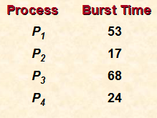
Example(cont)
The Gantt chart is:
Quantum = 20
Typically, higher average turnaround than SJF, but better response.
P₁
P₂
P₃
P₄
P₁
P₃
P₄
P₁
P₃
P₃
0
20
37
57
77
97
117
121
134
154
162

Slide 58
RR: Example
Processes (burst time): P1 (53), P2 (8), P3 (68), P4 (24)‏
  Time quantum: 20
Waiting time:
  P1 = (68-20) + (112-88) = 72
  P2 = (20-0) = 20
  P3 = (28-0) + (88-48) + (125-108) = 85
  P4 = (48-0) + (108-68) =88
  Average waiting time: (72+20+85+88)/4 = 66.25
  Average completion time: (125+28+153+112)/4 = 104.5
P1
P2
P3
P4
P1
P3
P4
P1
P3
P3
0
20
28
48
68
88
108
112
125
145
153

Slide 59
（1）The size of the time quantum
The performance of the RR algorithm depends heavily on the size of the time quantum
if the time quantum is extremely large, the RR policy is the same as the FCFS policy
if the time quantum is extremely small
  The overhead (for context switch) is high
  Throughput suffers
Balance short job's performance and long job's throughput
  Typical time quantum today is between 10ms to 100ms
  Typical context switching overhead is 0.1ms to 1ms
  Roughly 1% overhead due to context switching

Slide 60

Time Quantum and Context Switch Time
Notes:
假设只有一个10 个时间单元的进程。如果时间片是12 个时间单元，那么进程在一个时间片中结束，没有额外的开销。如果时间片是6个时间单元，那么进程就需要两个时间量，就会有一次上下文转换。如果时间量是1 个时间单位，那么就会发生9 次上下文转换，从而降低了进程的执行速度。
如果上下文转换时间为时间量的百分之十，那么约有百分之十的CPU时间用于上下文转换。

Slide 61
（2）Turnaround time depends on the size of the time quantum
if the time quantum is extremely small
  context-switch time is added in, the average turnaround time increases
  more context switches are required.
if the time quantum is extremely large
  RR scheduling degenerates to an FCFS policy.
  80 percent of the CPU bursts should be shorter than the time quantum.

Slide 62
（5）Multilevel Queue Scheduling
Definition
Multilevel Queue Scheduling
Multilevel Feedback Queue

Slide 63
Definition
Ready queue is partitioned into separate queues:
  foreground (interactive)
  background (batch)
Queues have different response-time requirements and so may have different scheduling needs
Each queue has its own scheduling algorithm, these two types of
  foreground – RR
  background – FCFS

Slide 64
Multilevel Queue Scheduling
Scheduling must be done between the queues
  Fixed priority scheduling
    (i.e., serve all from foreground then from background). Possibility of starvation.
  Time slice – each queue gets a certain amount of CPU time which it can schedule amongst its processes
    i.e., 80% to foreground in RR, 20% to background in FCFS

Slide 65

Multilevel Queue Scheduling
Solaris 2-----Fixed priority scheduling
Notes:
每个队列的绝对优先权都要高于更低优先权的队列。例如，批处理队列中的进程只有在系统进程队列、交互式进程队列和交互式编辑进程队列都为空时才能够运行。如果当一个批处理进程正在运行时一个交互式编辑进程进入就绪队列，那么该批处理进程将被抢占。Solaris 2 采用了这种算法。

Slide 66
Multilevel Feedback Queue
A process can move between the various queues; aging can be implemented this way
Multilevel-feedback-queue scheduler defined by the following parameters:
  number of queues
  scheduling algorithms for each queue
  method used to determine when to upgrade a process
  method used to determine when to demote a process
  method used to determine which queue a process will enter when that process needs service
Notes:
其思想是允许进程在队列之间移动，根据不同的CPU burst特点来区分进程。如果进程使用过多的CPU时间，那么它会被移到更低优先级队列。这种方案会将I/O型进程和交互式进程留在较高优先级队列。而在较低优先级队列中等待过长的进程会被移到较高优先级队列，这种形式的老化能阻止饥饿的发生。
通常通过如下的参量来定义多级反馈队列调度程序：
队列的数量
每个队列采用的调度算法
用于决定何时将一个进程提升到优先权更高队列的方法
用于决定何时将一个进程降到优先权更低队列的方法
用于决定一个需要服务的进程进入哪个队列的方法
多级反馈队列调度程序的定义使它成为最通用的CPU 调度算法

Slide 67
Example of Multilevel Feedback Queue
Three queues:
  Q₀ – RR with time quantum 8 milliseconds
  Q₁ – RR time quantum 16 milliseconds
  Q₂ – FCFS
Scheduling
  A new job enters queue Q0 which is served FCFS. When it gains CPU, job receives 8 milliseconds. If it does not finish in 8 milliseconds, job is moved to queue Q1.
  At Q1 job is again served FCFS and receives 16 additional milliseconds. If it still does not complete, it is preempted and moved to queue Q2.
Notes:
这种调度算法赋予CPU burst 等于或小于8 毫秒的进程最高优先权。这样的一个进程将很快获得CPU，完成它的CPU burst，然后离开并到它的下一个I/O burst。需要的时间大于8 毫秒但小于24 毫秒的进程也会很快得到服务，虽然它的优先权比更短的进程的优先权低。

Slide 68

Multilevel Feedback Queues

Slide 69
多级反馈队列调度算法
设有N个队列（Q1,Q2….QN），其优先级满足
Priority(Q1) > Priority(Q2) > … > Priority(QN)
即：位于Q1中的任何一个进程都要比Q2中的任何一个进程相对于CPU的优先级要高，依次类推。
Notes:
位于Q1中的任何一个作业(进程)都要比Q2中的任何一个作业(进程)相对于CPU的优先级要高

Slide 70
多级反馈队列调度算法（续）
进程进入队列的规则：
任何一个进程在进入待调度的队列等待时，首先进入优先级最高的Q1队列。
如果Q1队列的时间片为N，那么Q1中的任何一个进程在经历了一个时间片N以后，若还没有完成，则进入Q2队列等待，若Q2的时间片结束，作业还不能完成，进入Q3队列，….，以此进行下去，直至到达最后一个队列。

Slide 71
多级反馈队列调度算法（续）
处理机调度的规则1：
首先调度优先级高的队列中的进程。若高优先级中队列中已没有调度的进程, 则调度次优先级队列中的进程。
例如：Q1,Q2,Q3三个队列，只有在Q1中没有进程等待时，才去调度Q2，同理，只有Q1,Q2都为空时，才会去调度Q3

Slide 72
多级反馈队列调度算法（续）
处理机调度的规则2：
对于同一个队列中的各个进程，按照该队列的算法进行调度。例如，时间片轮转法 。
比如Q1队列的时间片为N，那么Q1中的作业在经历了一个时间片N后，若还没有完成，则进入Q2队列等待；若在Q2中轮转到一个时间片后，作业还没完成，再进入下一级队列，….,直至进入最后级别队列，其可能按照FCFS完成调度。

Slide 73
多级反馈队列调度算法（续）
处理机调度的规则3：
如果低优先级队列中的进程在运行时，又有新的较高优先级别的进程到达，那么完成正在进行的时间片后，CPU马上分配给新到达的进行（抢占式）

Slide 74
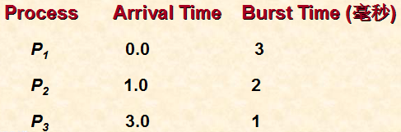
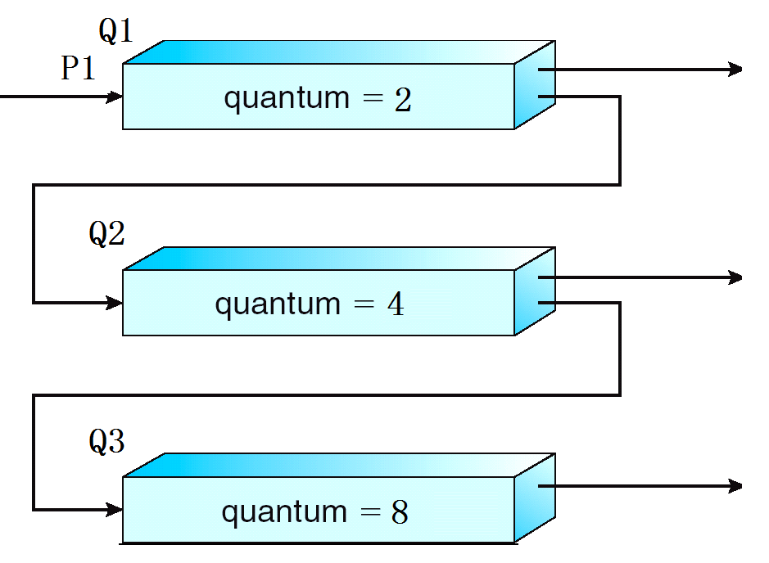
解答
时刻1：P2到达， 由于CPU忙，P2到Q1队列中等待
1~2时刻，CPU处理P1

Slide 75
举例
假设系统中有3个反馈队列Q1,Q2,Q3，时间片分别为2，4，8毫秒 。三个进程信息如下：
Process Arrival Time Burst Time (毫秒)
P₁ 0.0 3
P₂ 1.0 2
P₃ 3.0 1

Slide 76
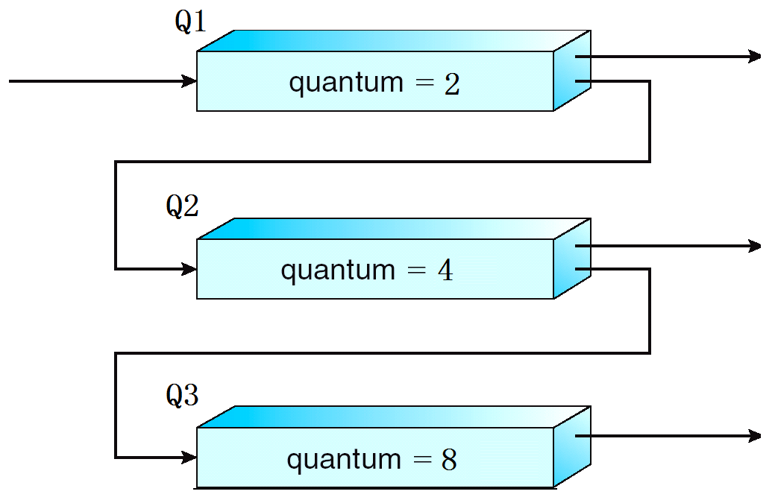
举例(续）

Slide 77
解答
时刻0：P1到达，0~1时刻执行P1

Slide 78
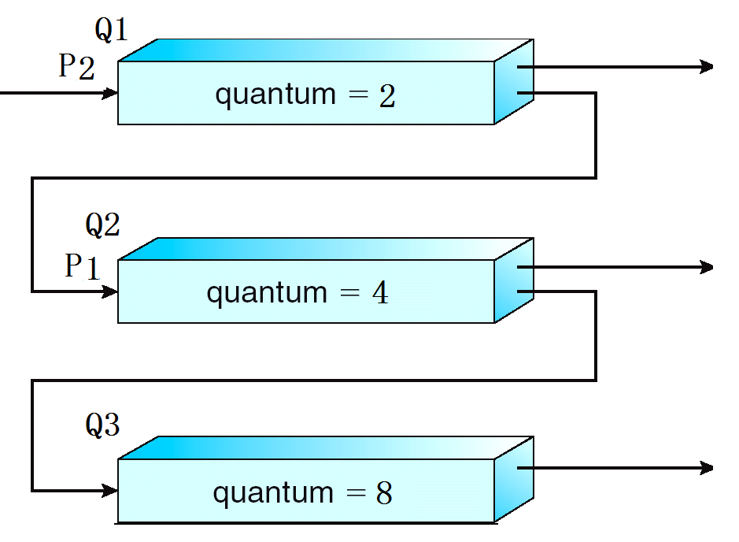
解答
时刻2：CPU时间片到，P1未完成，到Q2等待，CPU调度Q1上的P2
2~3时刻， CPU处理 P2

Slide 79
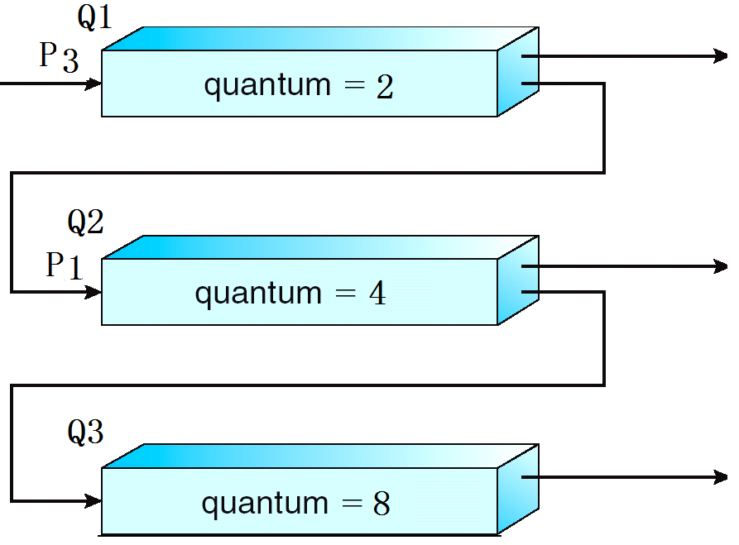
解答
时刻3：P3到达，到Q1对列中排队，3~4时刻，CPU继续处理P2

Slide 80
解答
时刻4：时间片到，P2处理完毕，CPU调度Q1中P3，4~5时刻，CPU处理P3

Slide 81
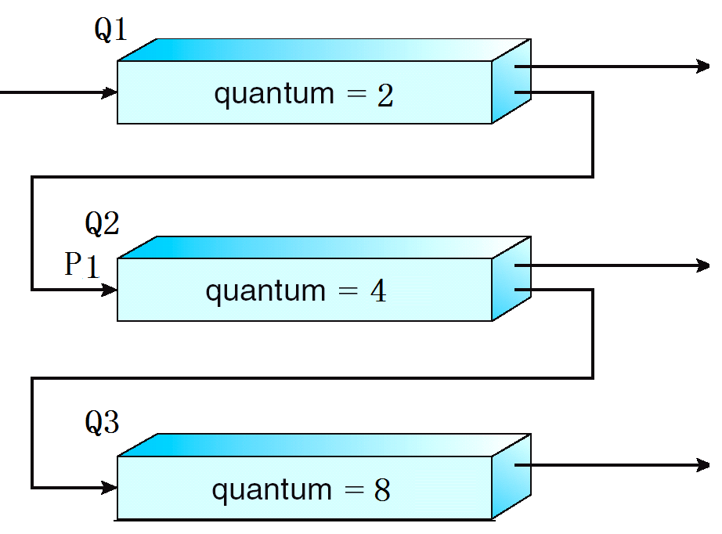
解答
时刻5：P3处理完，队列Q1为空，CPU调度Q2队列中的P1，5~6时刻处理P1

Slide 82
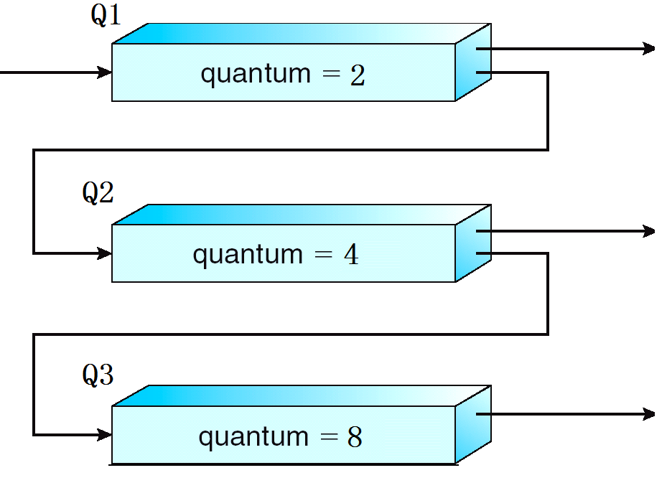
解答
时刻6：队列Q1为空，Q2为空，任务全部结束。

Slide 83
实例说明
时刻0~6完成了三个进程的任务，即共需要6秒
在多级反馈队列中，后申请的作业不一定后完成，例如P3，后进入就绪队列，而比P1先完成

Slide 84
多级反馈队列调度优缺点
多级反馈队列调度算法既能使高优先级的作业得到响应又能使短作业(进程)迅速完成：
  各个队列的时间片不一样。
  各个队列的时间片是随着优先级的增加而减少的。
  优先级越高的队列中它的时间片就越短。
  为了便于那些超大作业的完成，最后一个队列Q_{N}(优先级最低的队列)的时间片一般很大

Slide 85
4.Thread Scheduling
系统调度的是内核线程，而不是进程
用户线程由线程库管理
为了能在CPU 上运行，用户线程最终必须映射到相应的内核级线程，尽管这种映射可以是间接的，可使用轻量级进程(LWP)

Slide 86
(1) Scheduling methods
Local Scheduling
  How the threads library decides which thread to put onto an available LWP(轻量级进程 )
Global Scheduling
  How the kernel decides which kernel thread to run next.

Slide 87
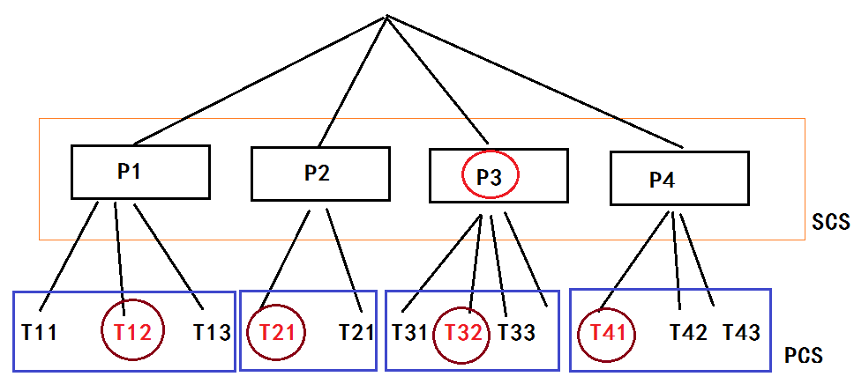
PCS与SCS
PCS（ PCS-Process-contention scope，进程竞争范围）
  在执行多对一模型和多对多模型的系统上，线程库调度用户级线程到一个有效的LWP 上运行
  competition for the CPU takes place among threads belonging to the same process.
SCS（系统竞争范围-- system-contention scope）
  决定调度哪个内核线程到CPU ，内核采用SCS来进行
先利用PCS选线程（Local Scheduling ），然后操作系统利用SCS （Global Scheduling）将内核线程调度到物理CPU 上

Slide 88
Pthread 调度
POSIX Pthread API
在线程生成过程中，允许指定是PCS 或SCS
Can be limited by OS – Linux and Mac OS X only allow PTHREAD_SCOPE_SYSTEM
Pthread IPC 为得到及设置竞争范围方法，提供下面两个函数：
  pthread_attr_setscope (pthread_attr_t *attr, int scope)
  pthread_attr_getscope(pthread_attr_t *attr,int scope)
  第一个参数:线程属性集的指针,第二个参数选项：
  PTHEAD_SCOPE_PROCESS 采用PCS 调度线程。
  PTHEAD_SCOPE_SYSTEM 采用SCS 调度线程。

Slide 89
说明
POSIX Pthread 程序分两步：
  首先决定现有的竞争范围并将之赋予PTHEAD_SCOPE_PROCESS
  然后将生成的独立线程，采用SCS 调度
在Linux 和Mac OS X系统中，仅允许特定的竞争范围值： PTHEAD_SCOPE_SYSTEM

Slide 90
Pthread Scheduling API
#include <pthread.h>
#include <stdio.h>
#define NUM_THREADS 5
int main(int argc, char *argv[]) {
int i, scope;
pthread_t tid[NUM THREADS];
pthread_attr_t attr;
/* get the default attributes */
pthread_attr_init(&attr);
/* first inquire on the current scope */
if (pthread_attr_getscope(&attr, &scope) != 0)
fprintf(stderr, "Unable to get scheduling scope\n");
else {
if (scope == PTHREAD_SCOPE_PROCESS)
printf("PTHREAD_SCOPE_PROCESS");
else if (scope == PTHREAD_SCOPE_SYSTEM)
printf("PTHREAD_SCOPE_SYSTEM");
else
fprintf(stderr, "Illegal scope value.\n"); }

Slide 91
Pthread Scheduling API
/* set the scheduling algorithm to PCS or SCS */
pthread_attr_setscope(&attr, PTHREAD_SCOPE_SYSTEM);
/* create the threads */
for (i = 0; i < NUM_THREADS; i++)
pthread_create(&tid[i],&attr,runner,NULL);
/* now join on each thread */
for (i = 0; i < NUM_THREADS; i++)
pthread_join(tid[i], NULL);
}
/* Each thread will begin control in this function */
void *runner(void *param)
{
/* do some work ... */
pthread_exit(0);
}

Slide 92
Java Thread Scheduling
JVM Uses a Preemptive, Priority-Based Scheduling Algorithm.
FIFO Queue is Used if There Are Multiple Threads With the Same Priority.
JVM Schedules a Thread to Run When:
  The Currently Running Thread Exits the Runnable State.
  A Higher Priority Thread Enters the Runnable State

Slide 93
5.Algorithm for a particular system
Multiple-Processor Scheduling
Real-Time Scheduling

Slide 94
Multiple-Processor Scheduling
CPU scheduling more complex when multiple CPUs are available
Homogeneous processors within a multiprocessor
Asymmetric multiprocessing – only one processor accesses the system data structures, alleviating the need for data sharing
Symmetric multiprocessing (SMP) – each processor is self-scheduling, all processes in common ready queue, or each has its own private queue of ready processes
  Currently, most common

Slide 95
Multiple-Processor Scheduling（续）
软 CPU 亲和性（affinity） 的特性: 进程一般不会在处理器之间频繁迁移，降低进程迁移的频率，减少产生的负载。
硬 CPU 亲和性（affinity）：用户应用程序可以显式地指定进程在哪个（或哪些）处理器上运行。
Processor affinity – process has affinity for processor on which it is currently running
  soft affinity：低版本Linux 内核
  hard affinity：例如2.6 版本的 Linux 内核
  Variations including processor sets
  相关的数据结构:task_struct , 成员cpus_allowed 位掩码---位掩码由 n 位组成，例如：具有 4 个物理 CPU 的系统可以有 4 位。如果这些 CPU 都启用了超线程，那么这个系统就有一个 8 位的位掩码
  Linux 内核 API ，修改位掩码或查看当前位掩码：
    sched_set_affinity() （用来修改位掩码）
    sched_get_affinity() （用来查看当前的位掩码）
CPU 亲和性（affinity） 就是进程要在某个给定的 CPU 上尽量长时间地运行而不被迁移到其他处理器的倾向性。

Slide 96
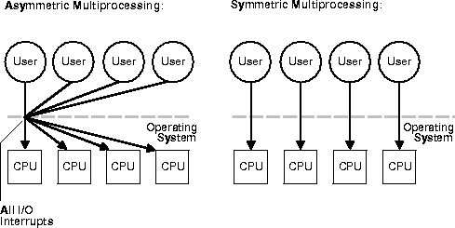
（1）Multiple-Processor Scheduling
Symmetric Multiprocessing (SMP) and Asymmetric multiprocessing

Slide 97
（1）Multiple-Processor Scheduling
CPU scheduling more complex when multiple CPUs are available.

Slide 98
Approaches to Multiple-Processor Scheduling
Homogeneous processors within a multiprocessor
  Symmetric Multiprocessing (SMP) – each processor makes its own scheduling decisions.
  Asymmetric multiprocessing – only one processor accesses the system data structures, alleviating the need for data sharing.

Slide 99
Load Balancing(负载平衡）
On SMP systems, it is important to keep the workload balanced among all processors, If SMP, need to keep all CPUs loaded for efficiency
不平衡：one or more processors may sit idle ，while other processors have high workloads, along with lists of processes awaiting the CPU

Slide 100
Two general approaches of load balancing
There are several general approaches to load balancing：
  Load balancing attempts to keep workload evenly distributed
  Pull：空闲CPU从其他忙的CPU队列中拉一个进程到当前CPU队列,
    Pull migration – idle processors pulls waiting task from busy processor)
  push ：忙的CPU队列将一个进程推送到空闲的CPU队列中
    Push migration – periodic task checks load on each processor, and if found pushes task from overloaded CPU to other CPUs
例如：Linux内核CPU负载均衡机制

Slide 101

NUMA and CPU Scheduling
非统一内存访问（NUMA）
Note that memory-placement algorithms can also consider affinity
Notes:
NUMA架构在逻辑上遵循SMP架构
NUMA通过提供分离的存储器给各个处理器，避免当多个处理器访问同一个存储器产生的性能损失

Slide 102
Multicore Processors
Recent trend to place multiple processor cores on same physical chip
Faster and consumes less power
Multiple threads per core also growing
  Takes advantage of memory stall to make progress on another thread while memory retrieve happens

Slide 103


Multithreaded Multicore System

Slide 104
（2）Real-Time Scheduling
Hard real-time systems(硬实时系统）
  由计算机主机板上的硬件 - 集成电路，如CPU, BIOS等来进行实时控制。CPU的运算周期按照事先设定的标准（例如Time slice)、或按某些硬件优先权分配，等等
  required to complete a critical task within a guaranteed amount of time.

Slide 105
（2）Real-Time Scheduling
Soft real-time computing （软实时系统）
  对非实时的操作系统，比如桌面计算机操作系统， 如Windows, 采取一定措施，来达到近似实时的效果
  用一个专门的软件部件，以达到快速反应
  例如："软实"的赌博游戏机、医疗器械、自动化控制设备
  requires that critical processes receive priority over less fortunate ones.

Slide 106

(2) Real-Time CPU Scheduling
Can present obvious challenges
Soft real-time systems – no guarantee as to when critical real-time process will be scheduled
Hard real-time systems – task must be serviced by its deadline
Two types of latencies affect performance
  Interrupt latency – time from arrival of interrupt to start of routine that services interrupt
  Dispatch latency – time for schedule to take current process off CPU and switch to another

Slide 107

Real-Time CPU Scheduling (Cont.)
Conflict phase of dispatch latency:
  Preemption of any process running in kernel mode
  Release by low-priority process of resources needed by high-priority processes

Slide 108

Priority-based Scheduling
For real-time scheduling, scheduler must support preemptive, priority-based scheduling
  But only guarantees soft real-time
For hard real-time must also provide ability to meet deadlines
Processes have new characteristics: periodic ones require CPU at constant intervals
  Has processing time t, deadline d, period p
  0 ≤ t ≤ d ≤ p
  Rate of periodic task is 1/p

Slide 109
Virtualization and Scheduling
Virtualization software schedules multiple guests onto CPU(s)
Each guest doing its own scheduling
  Not knowing it doesn’t own the CPUs
  Can result in poor response time
  Can effect time-of-day clocks in guests
Can undo good scheduling algorithm efforts of guests

Slide 110

Rate Montonic Scheduling
任务按单调速率优先级分配调度算法RMS (单调速率调度): 根据任务的执行周期的长短来决定调度优先级，那些具有小的执行周期的任务具有较高的优先级
A priority is assigned based on the inverse of its period
Shorter periods = higher priority;
Longer periods = lower priority
P₁ is assigned a higher priority than P₂.

Slide 111

Missed Deadlines with Rate Monotonic Scheduling

Slide 112

Earliest Deadline First Scheduling (EDF)
Priorities are assigned according to deadlines:
the earlier the deadline, the higher the priority;
the later the deadline, the lower the priority

Slide 113
Proportional Share Scheduling
T shares are allocated among all processes in the system
An application receives N shares where N < T
This ensures each application will receive N / T of the total processor time

Slide 114
POSIX Real-Time Scheduling
The POSIX.1b standard
API provides functions for managing real-time threads
Defines two scheduling classes for real-time threads:
  SCHED_FIFO - threads are scheduled using a FCFS strategy with a FIFO queue. There is no time-slicing for threads of equal priority
  SCHED_RR - similar to SCHED_FIFO except time-slicing occurs for threads of equal priority
Defines two functions for getting and setting scheduling policy:
  pthread_attr_getsched_policy(pthread_attr_t *attr, int *policy)
  pthread_attr_setsched_policy(pthread_attr_t *attr, int policy)

Slide 115
POSIX Real-Time Scheduling API
#include <pthread.h>
#include <stdio.h>
#define NUM_THREADS 5
int main(int argc, char *argv[])
{
int i, policy;
pthread_t_tid[NUM_THREADS];
pthread_attr_t attr;
/* get the default attributes */
pthread_attr_init(&attr);
/* get the current scheduling policy */
if (pthread_attr_getschedpolicy(&attr, &policy) != 0)
fprintf(stderr, "Unable to get policy.\n");
else {
if (policy == SCHED_OTHER) printf("SCHED_OTHER\n");
else if (policy == SCHED_RR) printf("SCHED_RR\n");
else if (policy == SCHED_FIFO) printf("SCHED_FIFO\n"); }

Slide 116
POSIX Real-Time Scheduling API (Cont.)
/* set the scheduling policy - FIFO, RR, or OTHER */
if (pthread_attr_setschedpolicy(&attr, SCHED_FIFO) != 0)
fprintf(stderr, "Unable to set policy.\n");
/* create the threads */
for (i = 0; i < NUM_THREADS; i++)
pthread_create(&tid[i],&attr,runner,NULL);
/* now join on each thread */
for (i = 0; i < NUM_THREADS; i++)
pthread_join(tid[i], NULL);
}
/* Each thread will begin control in this function */
void *runner(void *param)
{
/* do some work ... */
pthread_exit(0);
}

Slide 117
6.Operating System Examples
Linux scheduling
Windows scheduling
Solaris scheduling

Slide 118
（1）Linux scheduling
Linux Scheduling Through Version 2.5
Prior to kernel version 2.5, ran variation of standard UNIX scheduling algorithm
Version 2.5 moved to constant order O(1) scheduling time
  Preemptive, priority based
  Two priority ranges: time-sharing and real-time
  Real-time range from 0 to 99 and nice value from 100 to 140
  Map into global priority with numerically lower values indicating higher priority
  Higher priority gets larger q
  Task run-able as long as time left in time slice (active)
  If no time left (expired), not run-able until all other tasks use their slices
  All run-able tasks tracked in per-CPU runqueue data structure
    Two priority arrays (active, expired)
    Tasks indexed by priority
    When no more active, arrays are exchanged
  Worked well, but poor response times for interactive processes

Slide 119
Linux Scheduling in Version 2.6.23 +
Completely Fair Scheduler (CFS)
Scheduling classes
  Each has specific priority
  Scheduler picks highest priority task in highest scheduling class
  Rather than quantum based on fixed time allotments, based on proportion of CPU time
  2 scheduling classes included, others can be added
    default
    real-time
Quantum calculated based on nice value from -20 to +19
  Lower value is higher priority
  Calculates target latency – interval of time during which task should run at least once
  Target latency can increase if say number of active tasks increases
CFS scheduler maintains per task virtual run time in variable vruntime
  Associated with decay factor based on priority of task – lower priority is higher decay rate
  Normal default priority yields virtual run time = actual run time
To decide next task to run, scheduler picks task with lowest virtual run time

Slide 120

Linux CFS Scheduler Performance

Slide 121

Linux Scheduling (Cont.)
Real-time scheduling according to POSIX.1b
  Real-time tasks have static priorities
Real-time plus normal map into global priority scheme
Nice value of -20 maps to global priority 100
Nice value of +19 maps to priority 139

Slide 122
（2） Windows Scheduling
Windows uses priority-based preemptive scheduling
  Highest-priority thread runs next
Dispatcher is scheduler
Thread runs until (1) blocks, (2) uses time slice, (3) preempted by higher-priority thread
Real-time threads can preempt non-real-time
32-level priority scheme
Variable class is 1-15, real-time class is 16-31
Priority 0 is memory-management thread
Queue for each priority
If no run-able thread, runs idle thread

Slide 123
Windows Priority Classes
Win32 API identifies several priority classes to which a process can belong
  REALTIME_PRIORITY_CLASS, HIGH_PRIORITY_CLASS, ABOVE_NORMAL_PRIORITY_CLASS,NORMAL_PRIORITY_CLASS, BELOW_NORMAL_PRIORITY_CLASS, IDLE_PRIORITY_CLASS
  All are variable except REALTIME
A thread within a given priority class has a relative priority
  TIME_CRITICAL, HIGHEST, ABOVE_NORMAL, NORMAL, BELOW_NORMAL, LOWEST, IDLE
Priority class and relative priority combine to give numeric priority
Base priority is NORMAL within the class
If quantum expires, priority lowered, but never below base

Slide 124
Windows Priority Classes (Cont.)
If wait occurs, priority boosted depending on what was waited for
Foreground window given 3x priority boost
Windows 7 added user-mode scheduling (UMS)
  Applications create and manage threads independent of kernel
  For large number of threads, much more efficient
  UMS schedulers come from programming language libraries like C++ Concurrent Runtime (ConcRT) framework

Slide 125

Windows Priorities

Slide 126
（3） Solaris
Priority-based scheduling
Six classes available
  Time sharing (default) (TS)
  Interactive (IA)
  Real time (RT)
  System (SYS)
  Fair Share (FSS)
  Fixed priority (FP)
Given thread can be in one class at a time
Each class has its own scheduling algorithm
Time sharing is multi-level feedback queue
  Loadable table configurable by sysadmin

Slide 127
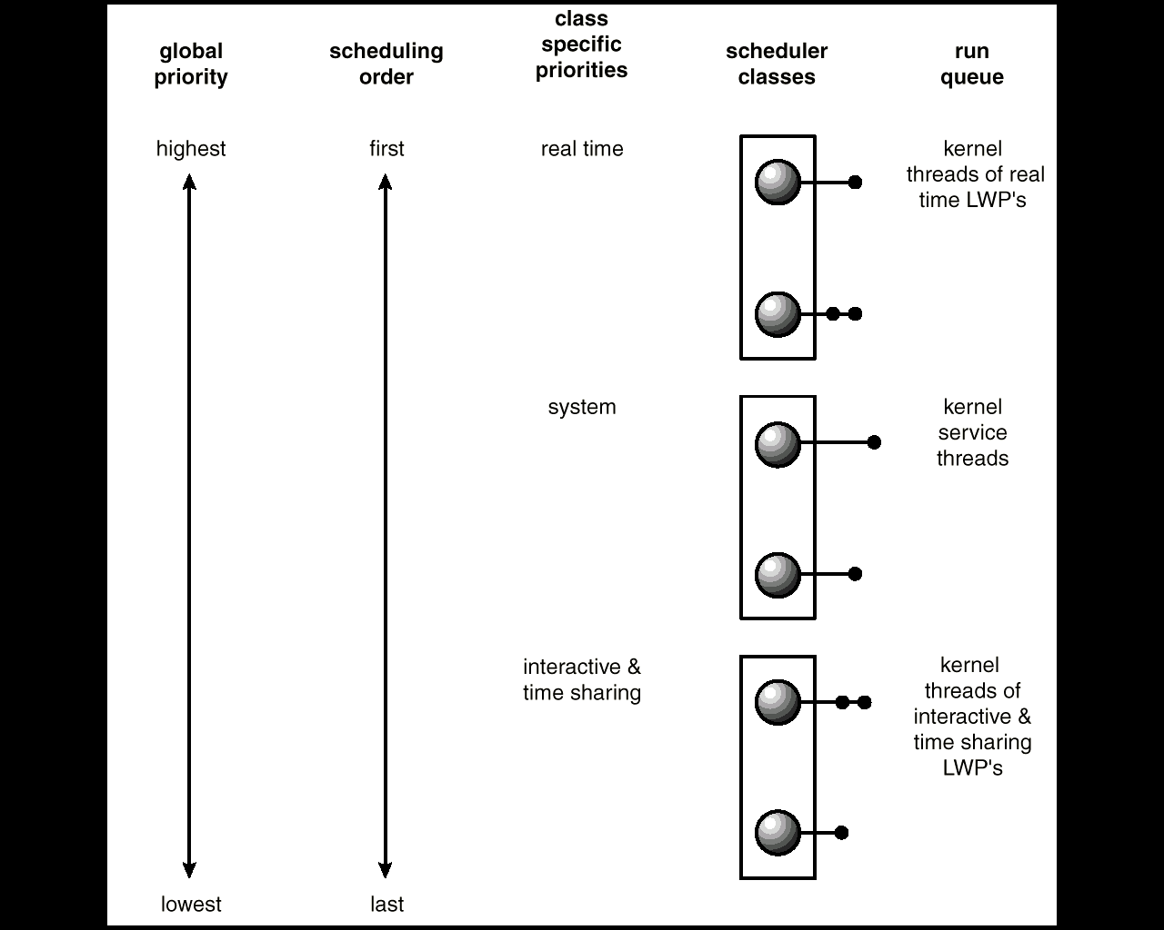
(2)Solaris 2 Scheduling

Slide 128
Solaris 2 采用优先级的调度策略
四类调度，每类有不同优先权和调度算法：
  实时
  系统
  分时
  交互式

Slide 129
分时调度策略---多级反馈
动态调整优先级
  时间片小----优先级高
  交互式进程优先级最高
  有较好的响应特点

Slide 130
使用系统类运行内核进程
系统类为内核服务
系统类调度不分时
如果占有CPU，一直运行，直到其：
  被阻塞，或
  被更高优先级进程所抢占

Slide 131

Solaris Dispatch Table

Slide 132

Solaris Scheduling

Slide 133
Solaris Scheduling (Cont.)
Scheduler converts class-specific priorities into a per-thread global priority
  Thread with highest priority runs next
  Runs until (1) blocks, (2) uses time slice, (3) preempted by higher-priority thread
  Multiple threads at same priority selected via RR

Slide 134

Algorithm Evaluation
How to select CPU-scheduling algorithm for an OS?
Determine criteria, then evaluate algorithms
Deterministic modeling
  Type of analytic evaluation
  Takes a particular predetermined workload and defines the performance of each algorithm for that workload
Consider 5 processes arriving at time 0:

Slide 135
Scheduling evaluation
Deterministic modeling
  Takes a predetermined workload and compute the performance of each algorithm for that workload
Queuing models
  Mathematical approach for handling stochastic workloads
Implementation/simulation
  Build system which allows actual algorithms to be run against actual data. Most flexible/general.

Slide 136



Deterministic Evaluation
For each algorithm, calculate minimum average waiting time
Simple and fast, but requires exact numbers for input, applies only to those inputs
  FCS is 28ms:
  Non-preemptive SFJ is 13ms:
  RR is 23ms:

Slide 137
Queueing Models
Describes the arrival of processes, and CPU and I/O bursts probabilistically
  Commonly exponential, and described by mean
  Computes average throughput, utilization, waiting time, etc
Computer system described as network of servers, each with queue of waiting processes
  Knowing arrival rates and service rates
  Computes utilization, average queue length, average wait time, etc

Slide 138
Simulations
Queueing models limited
Simulations more accurate
  Programmed model of computer system
  Clock is a variable
  Gather statistics indicating algorithm performance
  Data to drive simulation gathered via
    Random number generator according to probabilities
    Distributions defined mathematically or empirically
    Trace tapes record sequences of real events in real systems

Slide 139

Evaluation of CPU Schedulers by Simulation

Slide 140
Implementation
Even simulations have limited accuracy
Just implement new scheduler and test in real systems
  High cost, high risk
  Environments vary
Most flexible schedulers can be modified per-site or per-system
Or APIs to modify priorities
But again environments vary

Slide 141
Take-home message
FCFS
For fairness and response time: Round-robin
For optimal to short processes (minimize average waiting time, why?): SJF
  Preemptive mode: SRTF
  How to know the length of a CPU burst?
    prediction: exponential averaging
Can assign priority: priority-based
Know the characteristics of each kind of processes: multi-level queue
  For fairness: With feedback

Slide 142
Homework
assignment6

Slide 143
End of Chapter 6

